Slide 1

Retail Sales Prediction
A Capstone-Style Analysis of Market Dynamics
Machine Learning Pipeline • XGBoost vs Random Forest • SHAP Explainability

Slide 2




The Challenge & Objective
The Problem
The Objective
Retailers face significant losses due to inaccurate sales forecasting. Overstocking leads to high holding costs, while understocking results in lost revenue and customer dissatisfaction. Traditional linear models fail to capture complex, non-linear shopping behaviors.
Develop an end-to-end Machine Learning system to accurately predict total transaction value. The goal is to minimize prediction error (RMSE) and identify key revenue drivers using interpretable AI (SHAP) to inform strategic decision-making.

Slide 3
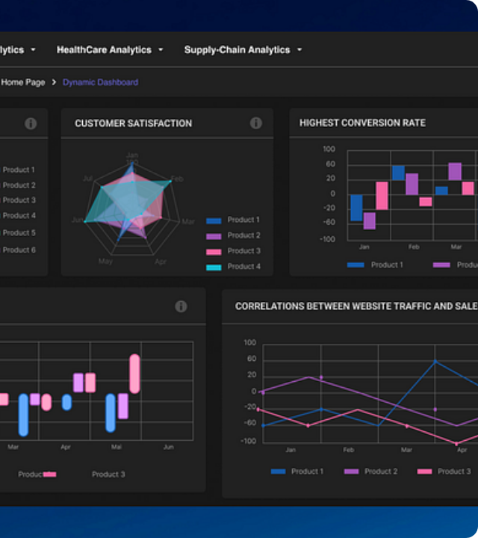
Data Landscape
Source: Customer Shopping Data (Istanbul).
Volume: 50,000+ Real-world transaction samples.
Span: 2021 – 2023 (3 Years).
Scope: 10 Major Shopping Malls.
Key Features: Demographics (Age, Gender), Transactional (Price, Quantity), and Temporal (Date) attributes.

Slide 4



Data Preprocessing Pipeline
Cleaning
Time Parsing
Target Creation
Splitting
Removed duplicates. Imputed 0.8% missing Age values with Median (34).
Converted invoice_date to datetime. Extracted Year, Month, Day.
Engineered Target Variable:
Total_Sales = Price × Quantity
80/20 Train-Test split to ensure robust evaluation on unseen data.

Slide 5






Feature Engineering Strategy
Temporal Features
Behavioral Features
Encoding
Decomposed dates into Month, Weekday, and Year to capture seasonality (e.g., Holiday spikes) and weekly shopping cycles (Weekend vs. Weekday).
Created customer_avg_price as a proxy for spending propensity. This helps model the distinction between high-value and budget shoppers.
Applied One-Hot Encoding to categorical variables: Gender, Payment Method, Category, and Mall, expanding feature space to 48 dimensions.

Slide 6
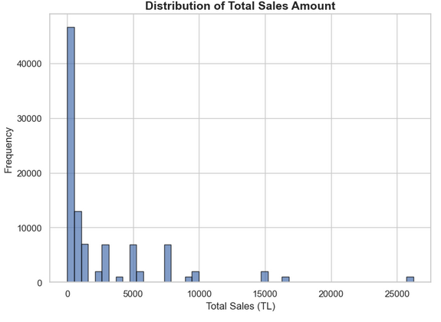
Sales Distribution
The target variable total_sales exhibits a classic long-tail distribution.
Right-Skewed: Majority of transactions are < 5,000 TL.
Outliers: Rare high-value transactions (> 10,000 TL) contribute significantly to revenue.
Implication: Models must be robust to outliers to minimize RMSE.

Slide 7
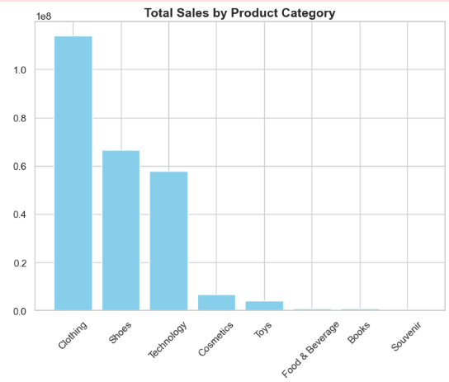
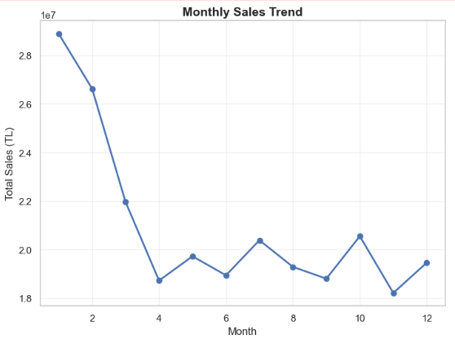
Seasonality & Category Analysis
Key Insights
Seasonal Peaks: Significant sales surges observed in November and December, driven by holiday shopping.
Category Dominance: Clothing and Shoes account for ~65% of total sales volume.
Payment Preference: Credit cards are used in 52% of transactions, correlating with higher basket values.

Slide 8








System Architecture
1. Ingestion
2. Processing
3. Reduction
4. Modeling
Raw CSV Data
Pandas DataFrame
Imputation
One-Hot Encoding
StandardScaler
PCA (95% Variance)
Dims: 48 → 22
Ensemble Methods
(RF & XGBoost)
Pipeline implemented using Scikit-Learn `Pipeline` & `ColumnTransformer`

Slide 9
Dimensionality Reduction (PCA)
Optimizing Feature Space
Encoding categorical variables resulted in a high-dimensional feature space (48 features), increasing computational cost and risk of overfitting.
Method: Principal Component Analysis (PCA).
Threshold: Retained 95% of variance.
Result: Reduced features from 48 to 22 components.
Benefit: Faster training and reduced multicollinearity.

Slide 10


Modeling Methodology
Random Forest
XGBoost
Bagging Technique: Constructs multiple decision trees in parallel and averages their predictions.
Boosting Technique: Builds trees sequentially, where each new tree corrects errors made by the previous ones.
•
Handles non-linear relationships well.
•
Gradient Boosting framework.
•
Robust to outliers.
•
Built-in L1/L2 regularization.
•
Less prone to overfitting than single trees.
•
Optimized for speed and performance.

Slide 11
Hyperparameter Tuning
Systematic optimization using RandomizedSearchCV with 5-fold Cross-Validation.
Parameter | Random Forest (Best) | XGBoost (Best)
N Estimators | 200 | 200
Max Depth | 10 | 6
Learning Rate | N/A | 0.1
Min Samples / Child | Split: 2 | Weight: 1
Subsample | N/A | 1.0
*XGBoost also utilized Early Stopping to prevent overfitting.

Slide 12
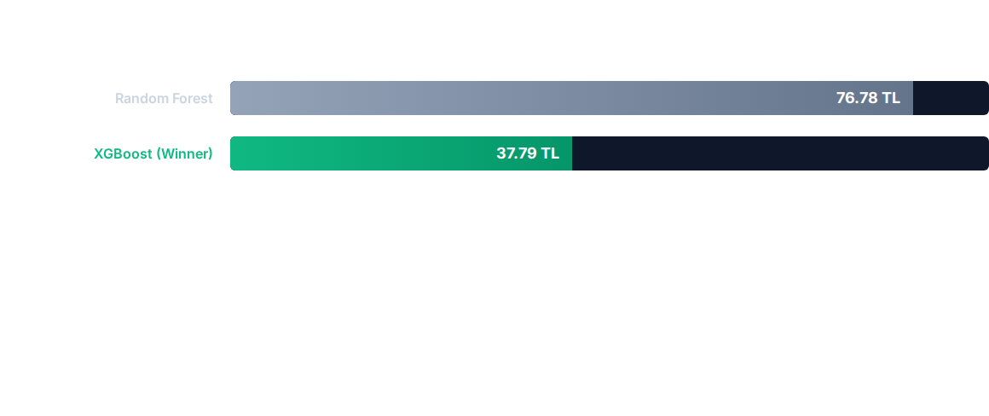

Performance Results (RMSE)
Conclusion: XGBoost achieved a 50.8% reduction in error compared to Random Forest. The R² score for XGBoost was 0.9999, indicating a near-perfect fit to the transaction logic.

Slide 13
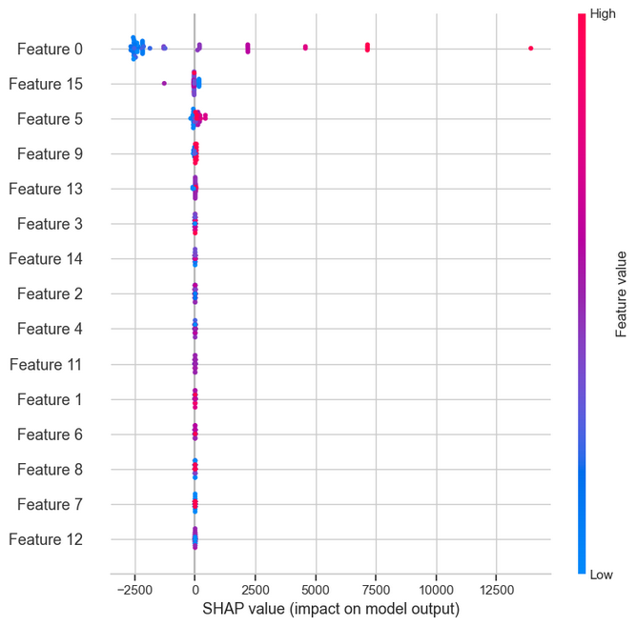
Explainability (SHAP)
Using SHapley Additive exPlanations to interpret the "Black Box" XGBoost model.
The Beeswarm plot visualizes:
Feature Importance: Ranked top-to-bottom.
Impact Direction: Red points (High values) vs Blue points (Low values) pushing predictions left or right.

Slide 14






Strategic Business Insights
Pricing Strategy
Inventory Optimization
Targeted Promos
Price is the #1 predictor. Linear correlation suggests elasticity is stable. Dynamic pricing can directly scale revenue without unexpected drops in volume.
Clothing & Shoes drive 65% of volume. Stock allocation should prioritize these categories, especially in the Mall of Istanbul.
Weekend & Q4 (Nov-Dec) spikes indicate optimal windows for "Flash Sales" to maximize existing high-traffic periods.

Slide 15
Conclusion & Future Directions
Future Roadmap
Project Success
Deep Learning: Implement LSTMs to better capture sequential time-series patterns.
The Capstone project successfully delivered a high-precision ML pipeline. XGBoost proved superior for this tabular regression task, providing actionable, granular sales forecasts.
Real-Time API: Deploy model via REST API for live dynamic pricing.
External Data: Integrate weather and economic indices for robust forecasting.

Slide 16
Q&A
Thank you for your attention.
Retail Sales Prediction Capstone

